Slide 1
POLlUTION
Pollution is the introduction of harmful materials into the environment. These harmful materials are called pollutants. Pollutants can be natural, such as volcanic ash. They can also be created by human activity, such as trash or runoff produced by factories. Pollutants damage the quality of air, water, and land

Slide 2
Types of pollution
*Air pollution
*Water pollution
*Noise pollution
*Plastic pollution
*Soil contamination
*Light pollution
*Visual pollution

Slide 3
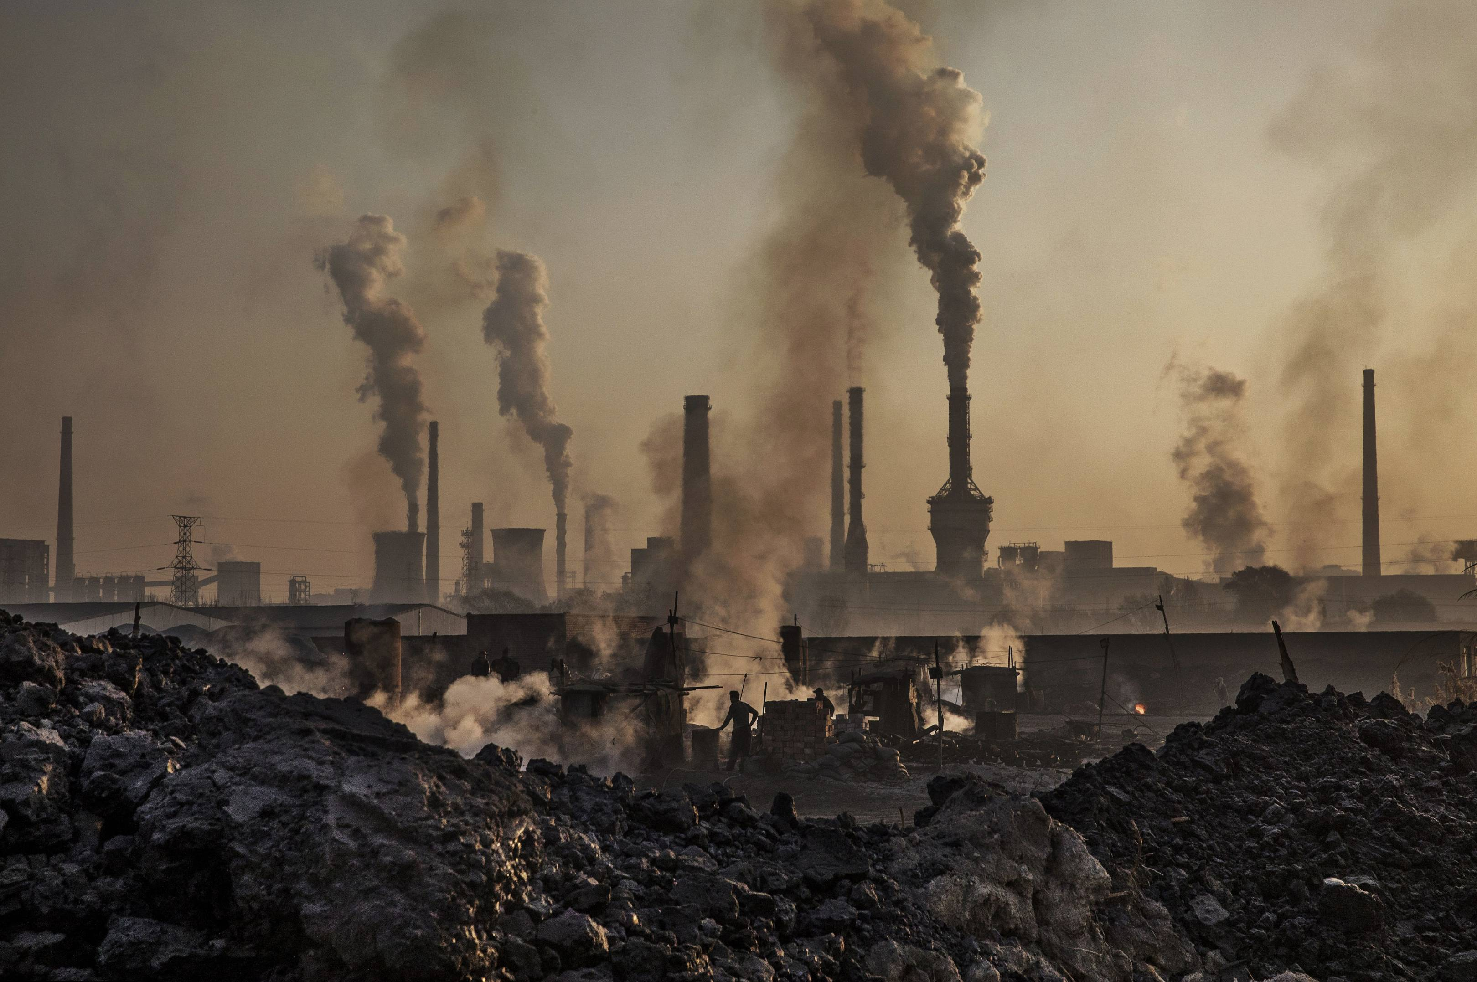
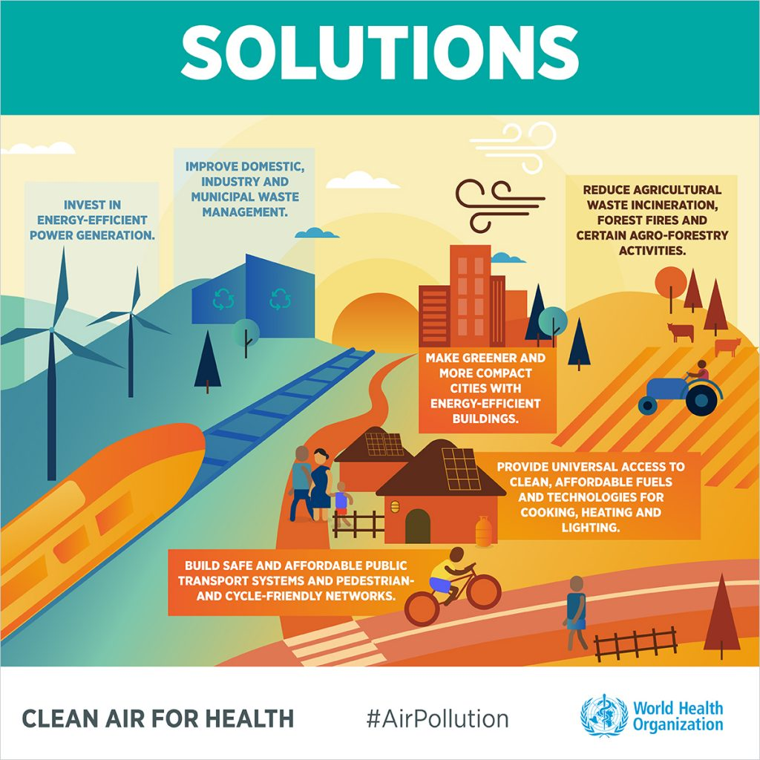
Air pollution
Air pollution is the introduction of harmful material into theatmosphere,causing damage to living organism and to the environment .
This Photo by Unknown Author is licensed under CC BY-SA
This Photo by Unknown Author is licensed under CC BY-SA-NC

Slide 4
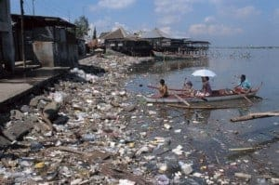
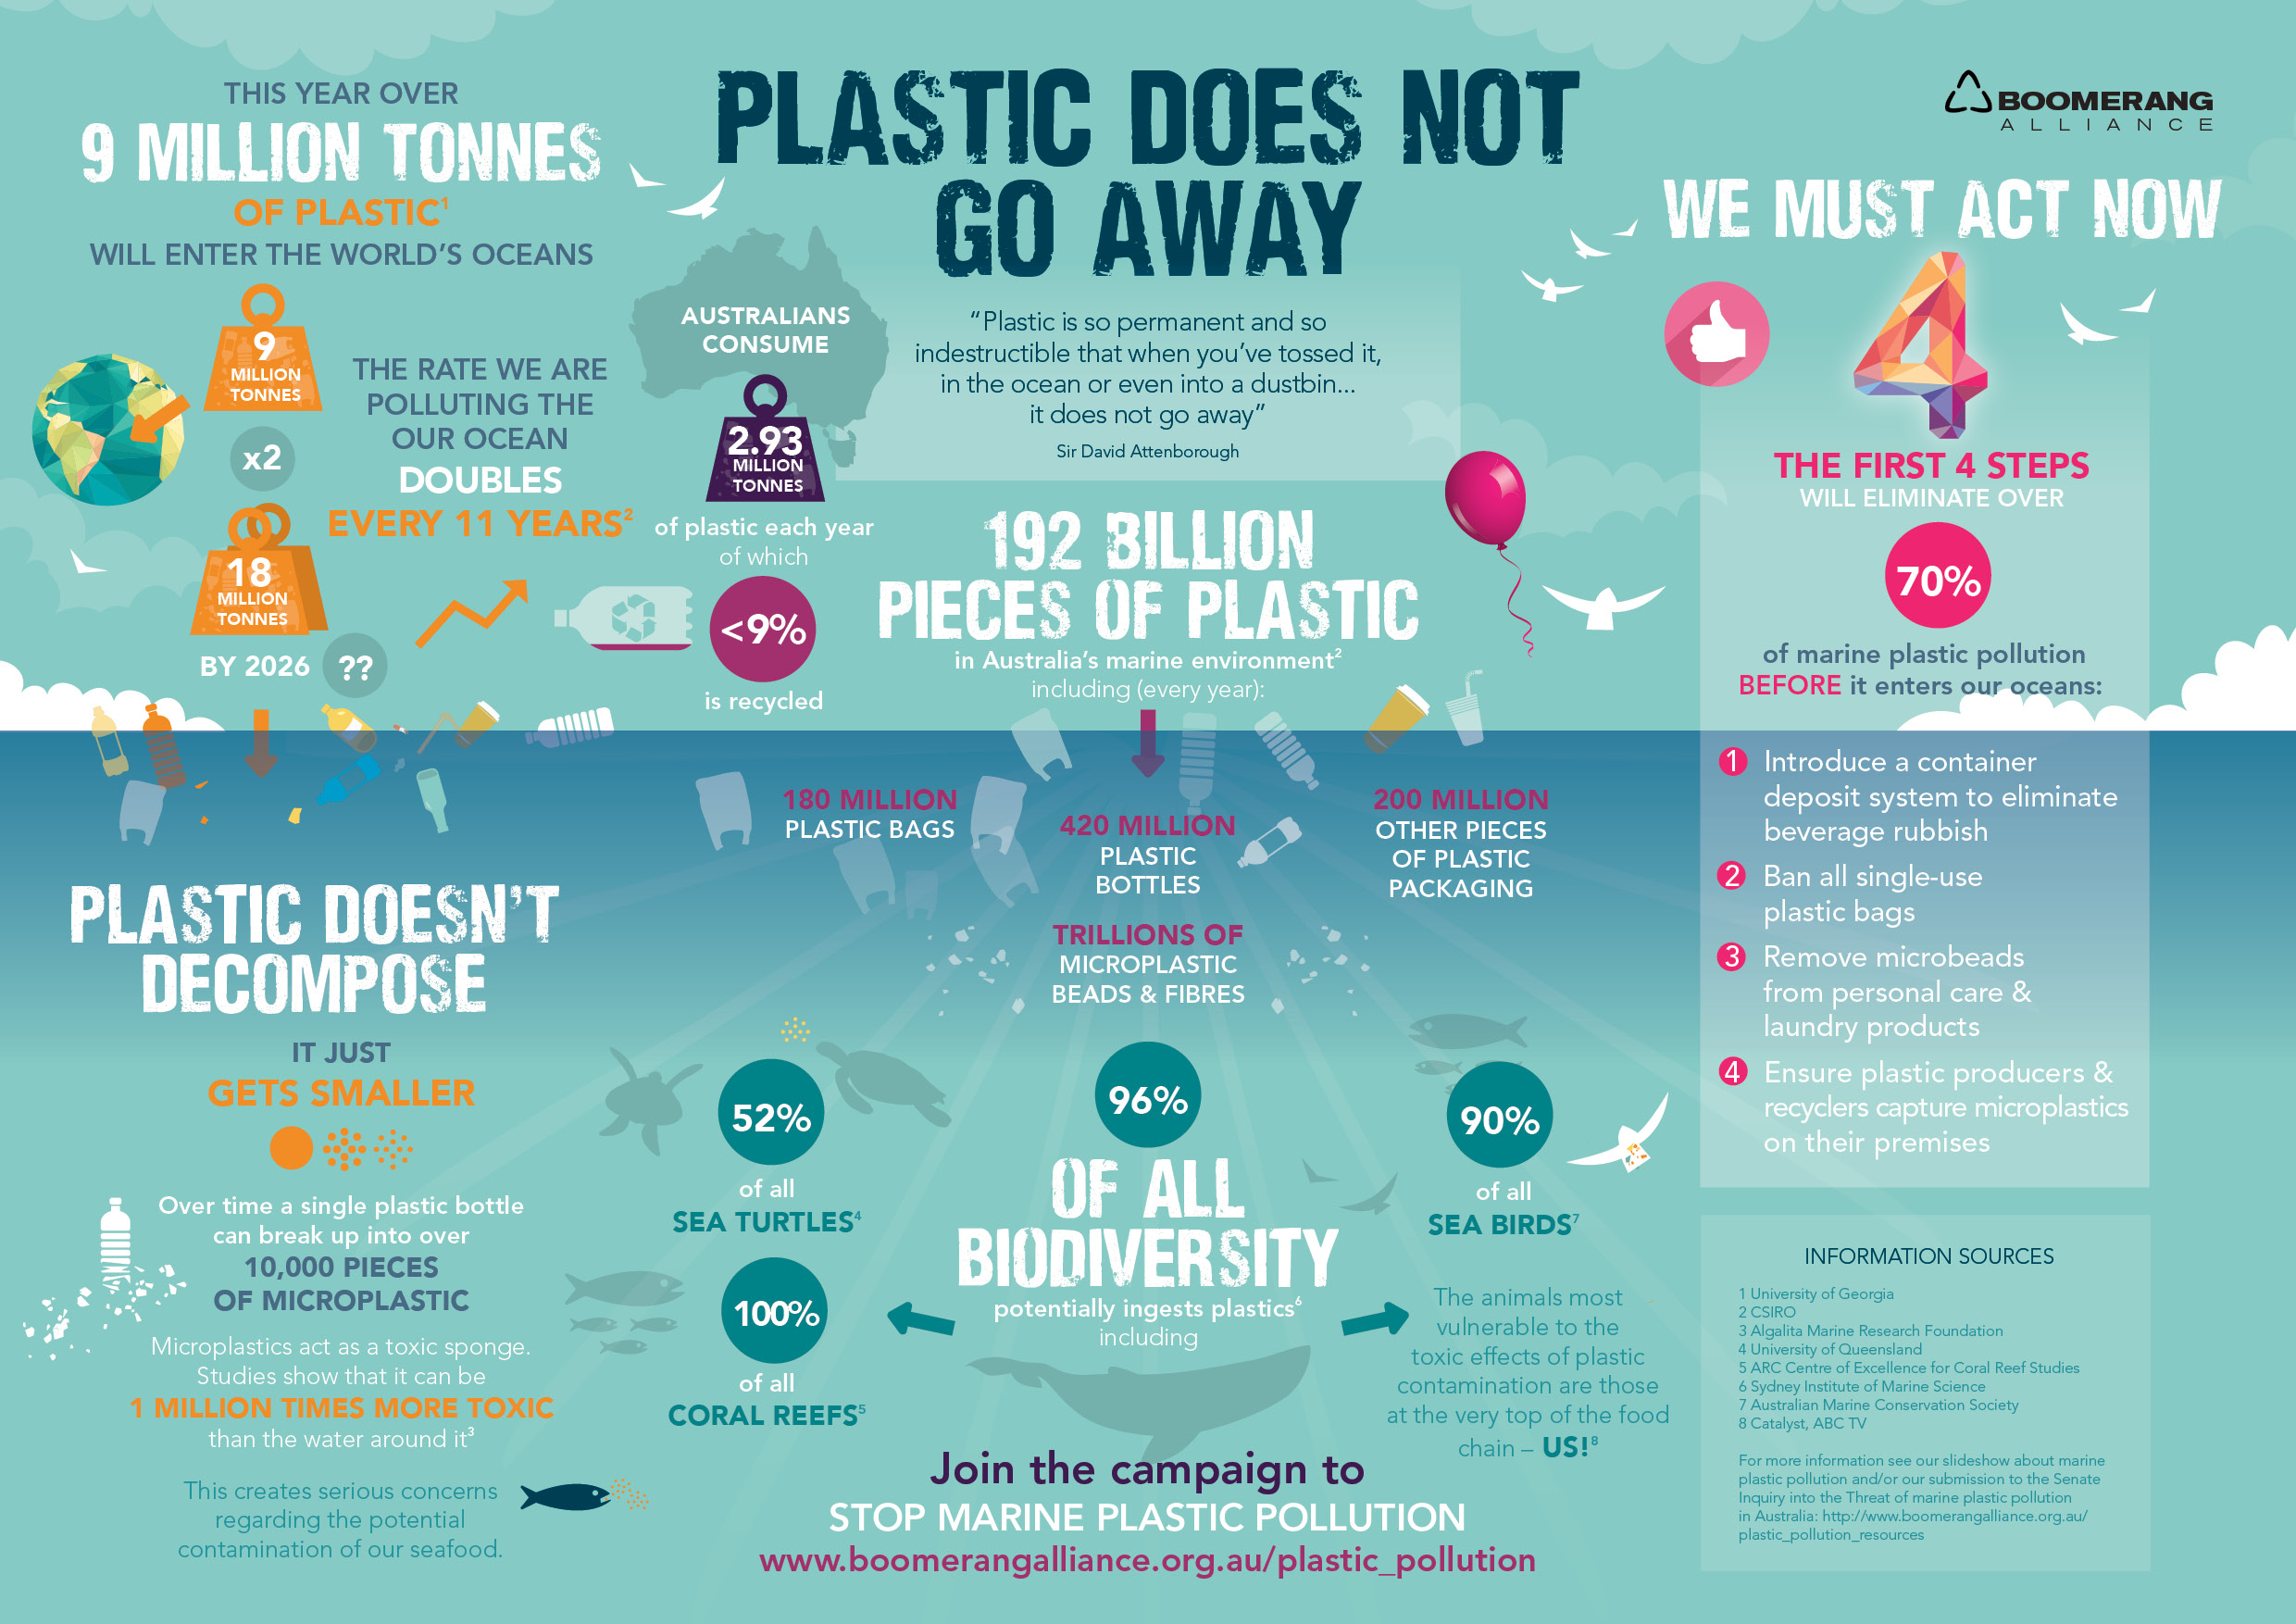
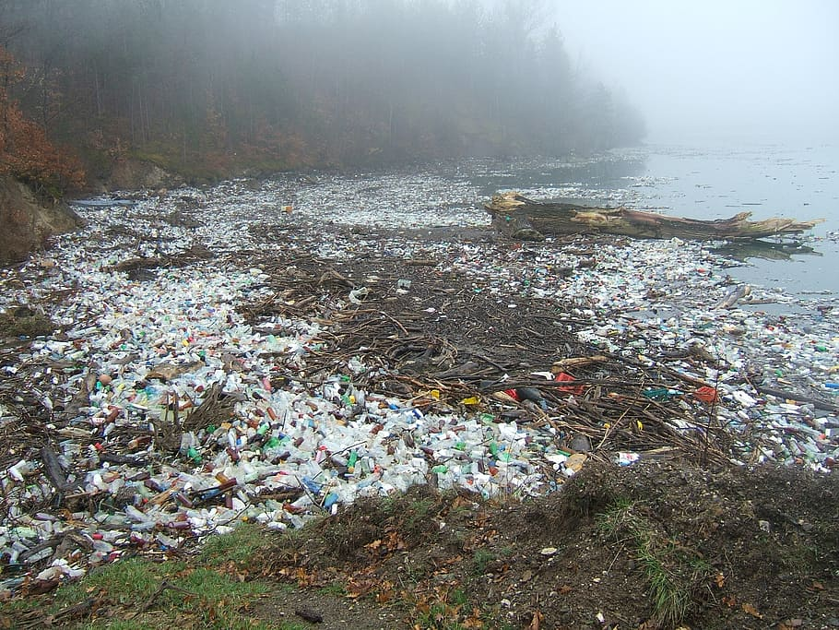
WATER POLLUTION
Water pollution is the contamination of water bodies (eg – lakes , rivers , oceans and groundwater ) water pollution occurs when pollutantsare directly or indirectly discharged into water bodies without adequate treatment to remove harmful compound .
This Photo by Unknown Author is licensed under CC BY-SA
This Photo by Unknown Author is licensed under CC BY-SA-NC

Slide 5
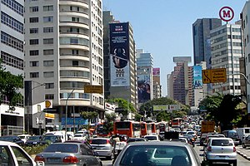
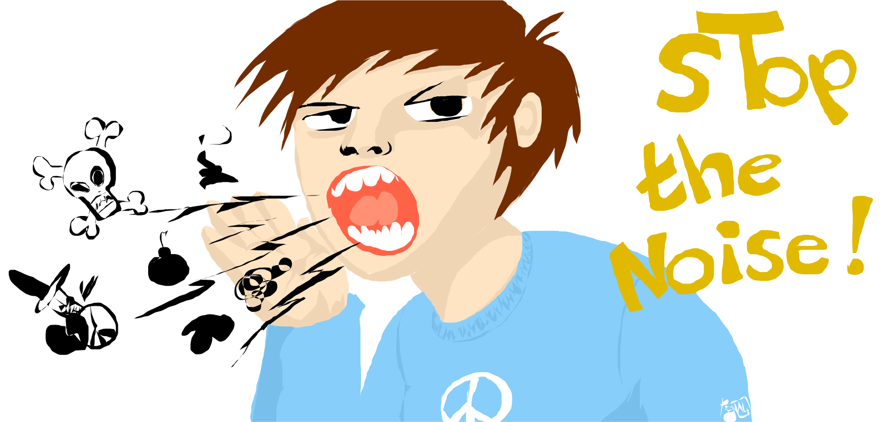
NOISE POLLUTION
This Photo by Unknown Author is licensed under CC BY-SA
This Photo by Unknown Author is licensed under CC BY
Noise pollution ,also known as environmental noise or sound pollution is the propagation of noise with harmful impact on the activity of human or animal life .

Slide 6
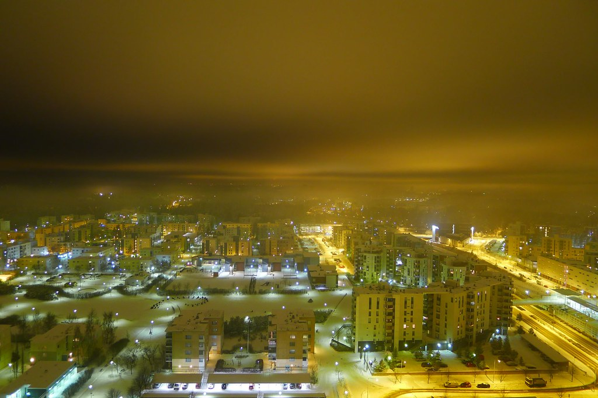
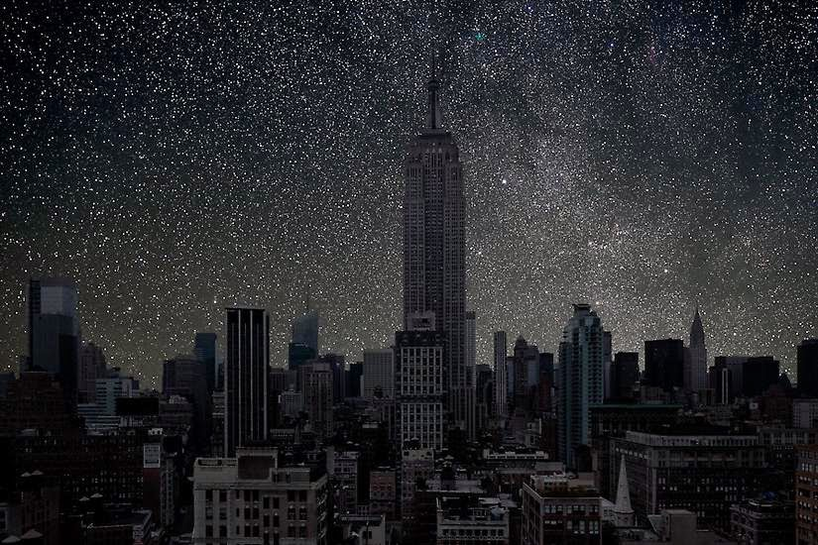
LIGHT POLLUTION
This Photo by Unknown Author is licensed under CC BY-SA
This Photo by Unknown Author is licensed under CC BY
Light pollution is the artificial illumination of the night sky , often limiting visibility of faint stars or others as luminous pollution .

Slide 7
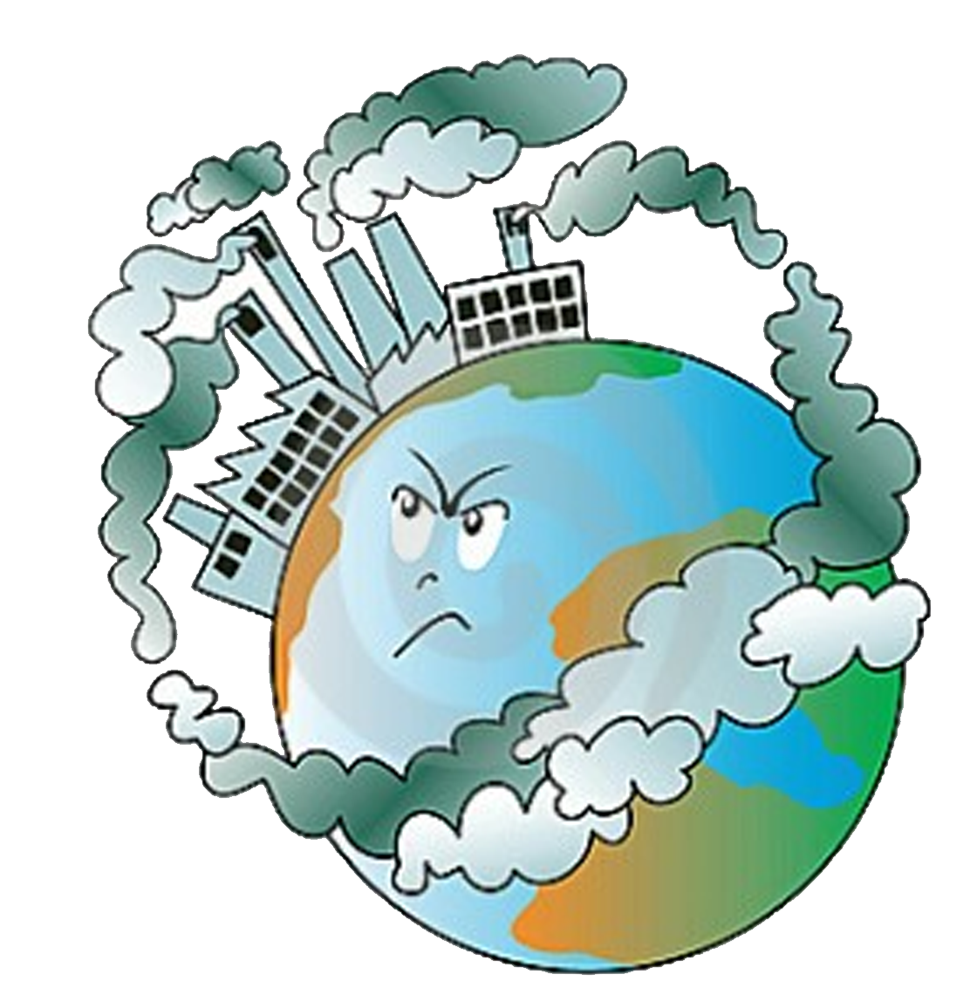
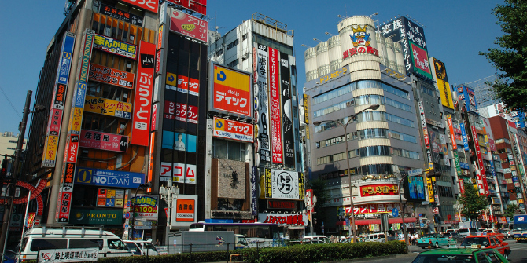
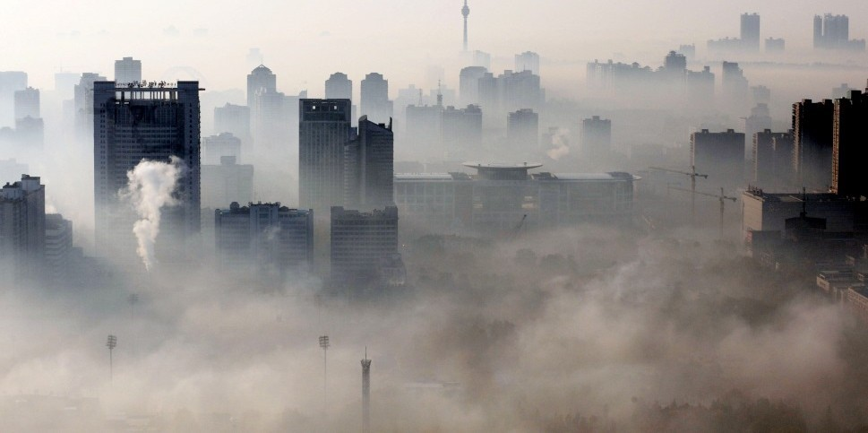
VISUAL POLLUTION
This Photo by Unknown Author is licensed under CC BY-SA-NC
* Visual pollution is the ruining of earths aestherics .
* Humans are the only organism that cause visual pollution .
* Visual pollution can cause the destruction of a habitat .
This Photo by Unknown Author is licensed under CC BY-NC-ND
This Photo by Unknown Author is licensed under CC BY-NC

Slide 8
STOP polluting you aren’t alone on this planet ……..

